Slide 1
Internship Progress Presentation
VISART Digital Phenotyping Team
CSVS Project

Slide 2
Agenda
01
05
Project Context & Objectives
ML Models Benchmarking​
02
06
Dataset Analysis Groups A, B, C
Results
03
07
Preprocessing Pipeline
(Filtering vs Inpainting)
Key Findings & Next Steps
04
CC Pipeline Analysis
2

Slide 3
Project Need & Objectives
1.

Slide 4
Project Context & Research Hypotheses
• Existing CNN pipeline (NOCC) gave a baseline, but lacked systematic preprocessing validation
• No study had compared lightweight ML against CNN for this task on the same data
The Challenge
Research Hypothesis
Can optimised, interpretable ML models (XGBoost, RF…) match or outperform a CNN on automated seed quality scoring?
Two approaches benchmarked on the same data:
① Stats / ML approach hand-crafted color features + regression
② CNN / DL approach end-to-end learned features (baseline)
Both tested with and without statistical filtering → 4 experiments

Slide 5
Study Design : 4 Core Experiments
Methodology: verify filtering → benchmark color spaces → run 4 experiments → compare & interpret
 | Without Filtering (NOCC) | With K=2 Statistical Filtering (CC)
CNN / Deep Learning | Experiment ① (baseline NOCC) | Experiment ② 🏆 Best CNN R²=0.893 | ρ=0.936
Stats / ML (XGB, RF…) | Experiment ③ (ML, no filter) | Experiment ④ 🏆 Best ML XGB-A: R²=0.852 | ρ=0.913
Step 1 : Verify filtering: run Shapiro-Wilk normality tests, plot per-channel histograms, select K
Step 2 : Benchmark color spaces on XGBoost (LAB, HSV, RGB, XYZ, combined) to decide which to keep
Step 3 : Apply dimensionality reduction: compare PCA (95% variance) vs feature selection (top-49 RF importance)
Step 4 : Final comparison: best ML pipeline vs best CNN across all 3 evaluation groups

Slide 6
Preprocessing Methods
1.

Slide 7
Preprocessing Pipeline
5 variants were tested on Zucchini 5 images LAB-based outlier filtering + 3 inpainting methods
Outlier Filtering
Statistical / LAB color-space filtering removes outlier pixels (noise, background artifacts)
Consistently improved model accuracy vs. raw, unfiltered images
Inpainting
Tested mean, linear and cubic interpolation to reconstruct filtered-out pixels
All three under-performed the simple filtered (no inpainting) baseline

Slide 8
Statistical Filtering The K Parameter
For each pixel p in each colour channel, keep p only if:
mean − K · σ ≤ p ≤ mean + K · σ
Outliers removed
Kept — [mean − K·σ , mean + K·σ]
Outliers removed
K Value Selection (Zucchini 5, CNN, colour-filtered):
K | R² ↑ | RMSE ↓ | Acc@0 ↑ | Acc@1 ↑
0.5 | 0.900 | 0.678 | 46.5% | 95.4%
1.0 | 0.909 | 0.647 | 53.5% | 97.7%
2.0 🏆 | 0.912 | 0.634 | 58.1% | 97.7%
3.0 | 0.910 | 0.646 | 60.4% | 95.4%
z-score | 0.906 | 0.660 | 53.5% | 97.7%
K=2 is optimal
removes genuine outliers (noise, glare, background artefacts)
while preserving the full colour range needed for quality rank prediction.

Slide 9
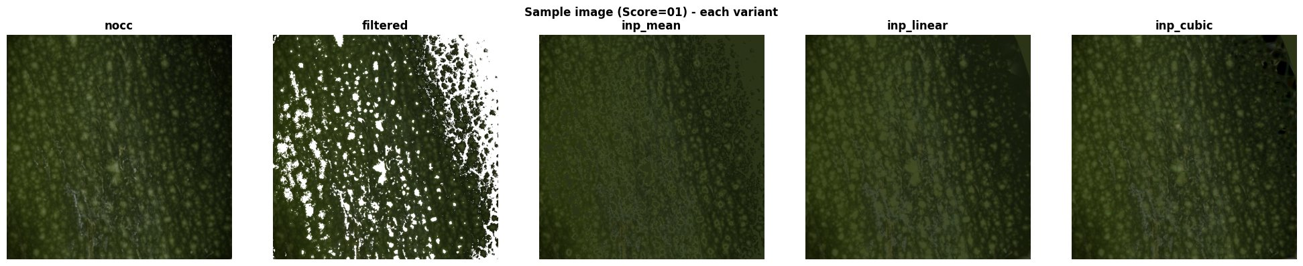
Inpainting Methods

Slide 10
CC Pipeline Analysis
1.

Slide 11
Dataset & Evaluation Groups
Pepper seeds (nocc) quality-scored 1–9 captured across 2 devices and 3 acquisition contexts
Group | Description | Images | Context
A Cross-Device | 2 devices, same portakabin context | 76 | CSVS00 + CSVS01
B Cross-Context | Same device, 3 contexts | 249 | Greenhouse 40 · Port.Ev 171 · Port.Comp 38
C Combined | All devices + all contexts | 287 | Most diverse
Group A only 76 images in one context. Impressive scores, limited validity.
Group B shows that context shift (greenhouse vs. portakabin) damages performance more than device change.
Group C is the most honest benchmark: combining devices and contexts improves robustness.

Slide 12
Cross-Group Generalisation Results
Group | Type | N | OOF R² | OOF Spearman ρ | OOF MAE | Mean R² ± Std | Mean ρ ± Std
Group A | NOCC | 76 | 0.968 | 0.985 | 0.355 | 0.967 ± 0.006 | 0.985 ± 0.007
Group A | CC | 76 | 0.970 | 0.983 | 0.328 | 0.971 ± 0.010 | 0.984 ± 0.005
Group B | NOCC | 249 | 0.887 | 0.941 | 0.545 | 0.885 ± 0.023 | 0.943 ± 0.018
Group B | CC | 249 | 0.892 | 0.948 | 0.547 | 0.890 ± 0.021 | 0.948 ± 0.013
Group C | NOCC | 287 | 0.907 | 0.955 | 0.515 | 0.900 ± 0.034 | 0.949 ± 0.024
Group C | CC | 287 | 0.893 | 0.946 | 0.551 | 0.884 ± 0.049 | 0.942 ± 0.029
Group A Misleading
R²=0.97 reflects intra-context color consistency. Only 76 images, 1 context no real domain shift.
Group B Context shift is the real challenge
R² drops to 0.885 when acquisition context changes (greenhouse → portakabin) a harder shift than device change.
Group C Most honest benchmark
R²=0.900, std=0.034. Combining both devices and contexts improves generalisation. Group C should drive model selection.

Slide 13
Preprocessing Methods Benchmarking
5 variants were tested on Zucchini 5 images LAB-based outlier filtering + 3 inpainting methods
Variant | Preprocessing Description | Outlier Handling | Inpainting Method
nocc | Cropped TIFF images no filtering | None | None
filtered | Statistical filtering (LAB color space) | Removed | None
inp_mean | Filtering + mean value filling (per channel) | Removed | Mean interpolation
inp_linear | Filtering + spatial interpolation (linear) | Removed | Linear interpolation
inp_cubic | Filtering + spatial interpolation (cubic) | Removed | Cubic interpolation
Method | MAE ↓ | RMSE ↓ | R² ↑ | Spearman ρ ↑ | Acc@0 ↑ | Acc@1 ↑ | Winner
NOCC (CNN, no filter) | 0.587 | 0.729 | 0.887 | 0.931 | 52.6% | 96.2%
Filtered ✅ | 0.552 | 0.712 | 0.893 | 0.936 | 55.4% | 95.8% | 🏆 Best
Inpainting (Mean) | 0.582 | 0.720 | 0.890 | 0.935 | 49.3% | 96.7%
Inpainting (Linear) | 0.599 | 0.745 | 0.882 | 0.930 | 49.3% | 94.4%
Inpainting (Cubic) | 0.575 | 0.731 | 0.887 | 0.932 | 51.6% | 95.8%

Slide 14
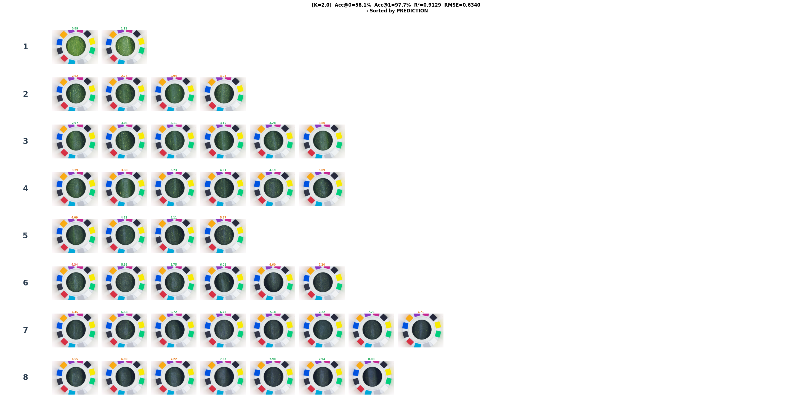
Preprocessing Methods Benchmarking

Slide 15
ML Models Benchmarking
1.

Slide 16
Gaussianity Analysis & Color Space Benchmarking
Why histograms?
Colour Space Benchmarking (best model = XGBoost )
The filter keeps [mean ± K·σ] valid only if the distribution is approximately Gaussian.
We plotted per-channel histograms before and after filtering, then ran Shapiro-Wilk tests (p < 0.05 → reject normality).
Most channels are right-skewed and non-Gaussian even after filtering.
→ Tree-based models (XGBoost, RF) are the right choice: they make no Gaussian assumption.
Space | R² ↑ | Spearman ρ ↑ | RMSE ↓
LAB 🥇 | 0.845 | 0.924 | 0.845
HSV 🥈 | 0.854 | 0.910 | 0.820
XYZ | 0.803 | 0.893 | 0.953
RGB | 0.807 | 0.890 | 0.944
LAB b* alone: ρ = −0.931 with quality score.
Combining all 4 spaces (288 features) raises R² from 0.845 → 0.852 (+0.7 pp), despite XYZ being 99.98% correlated with LAB-L*.
→ All colour spaces are kept for the final pipeline.

Slide 17
Color Space & Model Benchmarking
Model | Training Speed | Robust to Noise | High Dimensions | Key Characteristic
XGBoost | Medium-Slow | Very Good | Good | Gradient-boosted trees best for structured features
Random Forest | Fast-Medium | Very Good | Good | Ensemble of trees most robust, Acc@1 = 93%
SVM | Medium-Slow | Good | Excellent | Margin-based classifier needs feature scaling
Color Space | Best Model | R² ↑ | RMSE ↓ | MAE ↓ | Spearman ρ ↑
LAB | XGBoost | 0.845 | 0.845 | 0.661 | 0.9235
HSV | XGBoost | 0.854 | 0.820 | 0.647 | 0.9099
XYZ | XGBoost | 0.803 | 0.953 | 0.728 | 0.8930
RGB | XGBoost | 0.807 | 0.944 | 0.731 | 0.8896
LAB b* alone correlates at ρ = −0.931 with quality score. Despite XYZ being 99.98% correlated with LAB-L*, combining all 4 color spaces raised R² from 0.8065 → 0.8444 (+3.8 pp).

Slide 18
ML Model Benchmarking Results
Pipeline | Feature Set | R² ↑ | RMSE ↓ | MAE ↓ | Spearman ρ ↑ | Acc@1 ↑
XGB-A (All CS) 🏆 | RGB+HSV+LAB+XYZ | 0.852 | 0.826 | 0.675 | 0.9132 | 88.4%
RF-B (All CS) | RGB+HSV+LAB+XYZ | 0.844 | 0.847 | 0.695 | 0.9221 | 93.0%
XGB-B (LAB only) | LAB | 0.842 | 0.853 | 0.709 | 0.9183 | 88.4%
SVM-A (LAB+HSV-S+texture) | LAB + HSV-S + texture | 0.838 | 0.865 | 0.727 | 0.9207 | 93.0%
RF-A (HSV+LAB) | HSV + LAB | 0.829 | 0.890 | 0.735 | 0.9232 | 88.4%
SVM-B (LAB only) | LAB | 0.788 | 0.990 | 0.838 | 0.9084 | 93.0%
PCA (95% variance, 49 components) reduced R²from 0.852 → 0.741 (XGB-A).
Feature Selection(top-49 RF importance) retained R² = 0.849 withSpearman ρ = 0.927
XGB-A leads on R² and RMSE.
RF-B is preferred when top-1 classification accuracy matters most (93%).

Slide 19
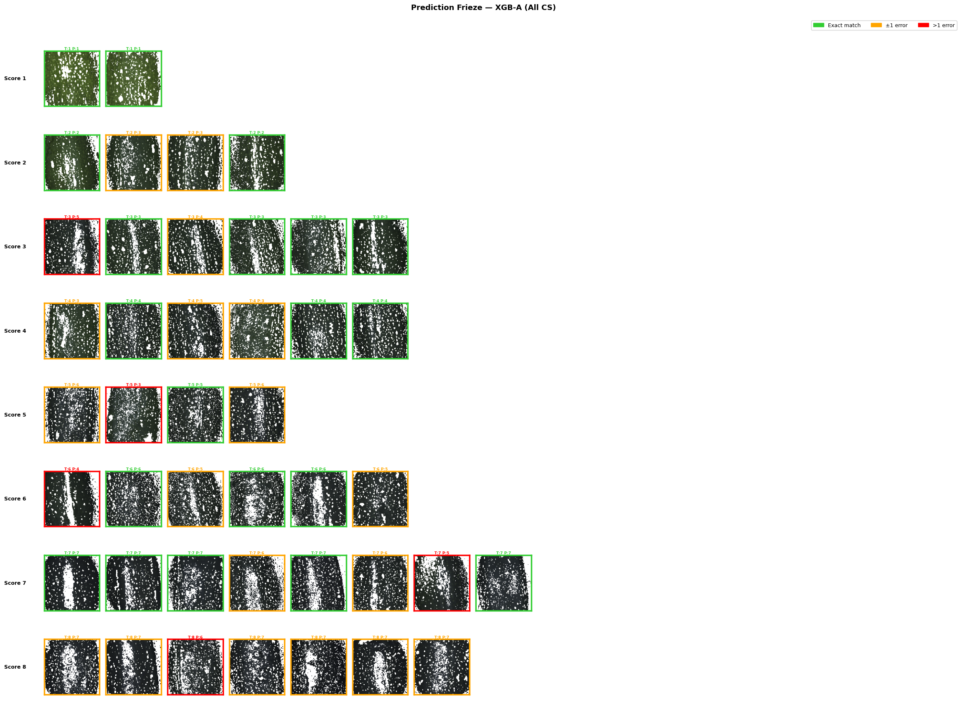
ML Model Benchmarking Results

Slide 20
CNN vs ML Head-to-Head Comparison
Best CNN (Experiment ②: CNN on K=2 filtered)
Best ML (Experiment ④: XGB-A on K=2 filtered)
Metric | Value
R² | 0.893
Spearman ρ | 0.936
MAE | 0.552
Acc@1 | 95.8%
Metric | Value
R² | 0.852 (−4.1 pp)
Spearman ρ | 0.913 (−2.3 pp)
MAE | 0.675 (+0.123)
Acc@1 | 88.4% (RF: 93%)
Best CNN = NOCC variant (K=2 filtered input).
Inpainting (mean/linear/cubic) consistently degraded CNN results.
Verdict
CNN still leads on regression metrics.
ML closes the gap to within 4 pp R² with no GPU, faster retraining, and full interpretability.
For maximum accuracy: CNN + K=2 filtering is the reference.

Slide 21
Key Takeaways & Next Steps
Summary of the main findings and recommended directions
What We Found
Next Steps
• LAB filtering is the most effective preprocessing step removes genuine noise
• Validate best pipeline (XGB-A / RF-B) on additional species
• Inpainting hurts: fabricated pixels confuse the CNN
• Explore image-level fusion of colour + spatial texture features
• XGBoost + all 4 color spaces: R²=0.852, RMSE=0.826, ρ=0.913
• Add ratio channels investigating their importance for the ml
• RF-B achieves top-1 accuracy of 93% highest classification accuracy
• Run Shapiro–Wilk normalisation test after extended filtering
• Feature selection (top-49) beats PCA retains non-linear structure
• Consider cross-species transfer learning for the CNN baseline
• Context shift impacts generalisation more than device change
• Group C gives best robustness vs. accuracy trade-off

Slide 22
Thank you

Slide 23
Objectif
1. Evaluate image preprocessing strategies (filtering + inpainting) for seed images
2. Benchmark CNN vs. classical ML models (SVM, RF, KNN, XGBoost) on color features
3. Compare color spaces: RGB, HSV, LAB, XYZ individually and combined
4. Apply PCA vs. feature selection for dimensionality reduction
5. Analyse cross-device and cross-context generalisation across 3 evaluation groups
Build and compare image preprocessing pipelines (filtering, inpainting) for raw seed images
Benchmark CNN vs. classical ML models (SVM, Random Forest, KNN, XGBoost) on color features
Evaluate generalization across different devices and acquisition contexts
Identify the most accurate and robust pipeline for the CSVS project

Slide 24
Project Context
The Challenge
Investigating the importance of the different filtering methods with cnn and ml
Comparing between ML and DL capability
Testing gaussianity before and after filtering
Benchmarking different color spaces for ml
The CSVS Project
Predicts a quality score (1–9 scale) from seed images
Combines image preprocessing → color feature extraction → ML regression
Species studied: Zucchini (preprocessing) and Pepper (ML benchmarking)
Devices: CSVS00 (Comp) and CSVS01 (Ev), multiple acquisition contexts

Slide 25
Datasets & Evaluation Groups
Pepper seeds (nocc) — scored 1–9 — captured across 2 devices & 3 acquisition contexts
Group | Description | Images | Sources | Source Detail
Group A | Cross-Device | 76 | 2 datasets | CSVS00 / CSVS01 — scores 1–9
Group B | Cross-Context, Same Device | 249 | 3 datasets | Comp_Port: 38 | Ev_Green: 40 | Ev_Port: 171 — scores 1–9
Group C | Combined (Both Devices & Contexts) | 287 | 4 datasets | Comp_Port00: 38 | Comp_Port01: 38 | Ev_Green: 40 | Ev_Port: 171
⚠ Group A inflates scores (76 images, 2 devices only — no real-world domain shift). Group B reveals context matters more than device. Group C is the most honest benchmark for generalisation.
Each seed image manually annotated with a quality score (1–9 scale) as ground truth
Group A – Cross-device: 76 images from 2 devices (CSVS00 / CSVS01)
Group B – Cross-context, same device: 249 images, 3 contexts (imbalanced 171/38/40)
Group C – Combined: 287 images spanning both devices and contexts

Slide 26
Color Space & Model Benchmarking
Classical ML Models Considered:
Compared a CNN baseline with classical ML models: SVM, Random Forest, KNN, XGBoost
Benchmarked 4 color spaces (RGB, HSV, LAB, XYZ) – HSV and LAB performed best individually
Combining all color spaces gave a further gain, despite high correlation between channels
Targeted feature selection clearly outperformed PCA for dimensionality reduction

Slide 27
Full Pipeline Comparison
All pipelines — XGB-A (all 4 color spaces) is the overall winner on R² and RMSE
Best Pipeline
XGBoost on all 4 color spaces combined: R² = 0.85, Spearman ρ = 0.91
Random Forest close behind, with the highest top-class accuracy (93%)
Generalization
High accuracy on one device (Group A) does not prove robustness
Context shift (e.g. greenhouse vs. portakabin) hurts performance more than device change
Combining devices & contexts (Group C) gives the best accuracy/robustness trade-off

